Slide 1
Health Tracking Scalable System
Presenter Name - Tanmay Bagla
Email - baglat@tcd.ie
Date - 26/09/2019

Slide 2
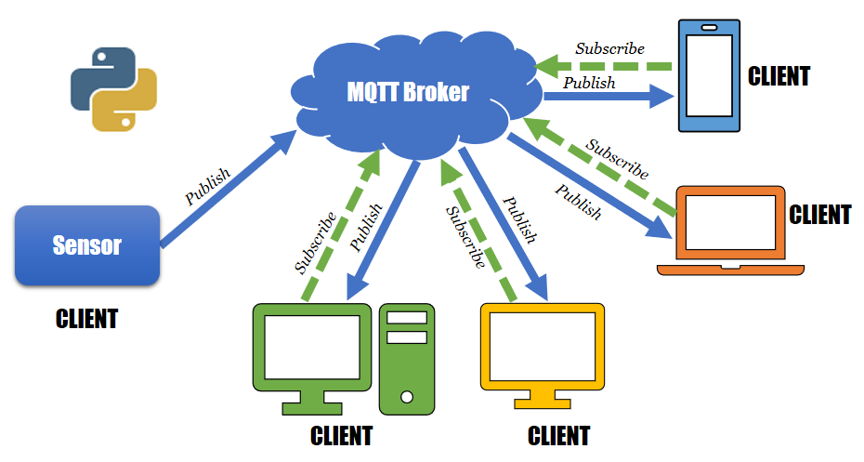
MQTT
MQTT is a publish/subscribe protocol that uses a client/server model, where every sensor is a client and connects to a server, known as a broker, over a transmission control protocol.
Why MQTT?
More efficient information distribution.
High scalability.
Requires less network bandwidth.
Well suited for remote sensing and control.
Highly secured.

Slide 3
Key Approaches
Used a flow-based development tool called Node-Red for wiring together different body sensors with MQTT broker using visual programming.
Provided secure connection between MQTT broker and AWS cloud by attaching AWS certificate, policies and by using its private key.
Data generated from multiple sensors is transferred to AWS cloud through MQTT protocol for storage purpose.
Established peer to peer connection in case of node failure.
Created a dashboard through Node-Red to display real time data.

Slide 4
Learning
What went well?
Notification pop ups are displayed on the dashboard for critical health conditions.
Connection to peer network is implemented in case of error using catch node.
Connection and communication between two instances having multiple sensors is implemented.
What didn’t went well?
Not able to use Sensor tags in node red for simulation using real time sensors.
Could not send email notification for critical health conditions in justifiable format.

Slide 5
Key Challenges
Latency – As we have used MQTT to establish the connection between the peers, it will reduce latency.
Node failure/connection break – Catch nodes and peer to peer connection are implemented to handle node failures.
Security – TLS connection between peers are implemented using certificates and policies.
Notes:
The apps which have an additional option of downloading a plugin of our application where in the drivers sign up and agree to comply with the slot-based system - this plugin will come in play when the driver enters the event area.
Check points to ensure that people who enter are 100% willing to comply with the slot-based driving system.

Slide 6
Platform
Node-red is user friendly, highly secured browser based environment.
It is highly scalable.
MQTT is a publish/subscribe protocol that uses a client/server model, where every sensor is a client and connects to a server, known as a broker, over a transmission control protocol.
Sensors are connected to MQTT broker.
It required low bandwidth for communication.

